Slide 1
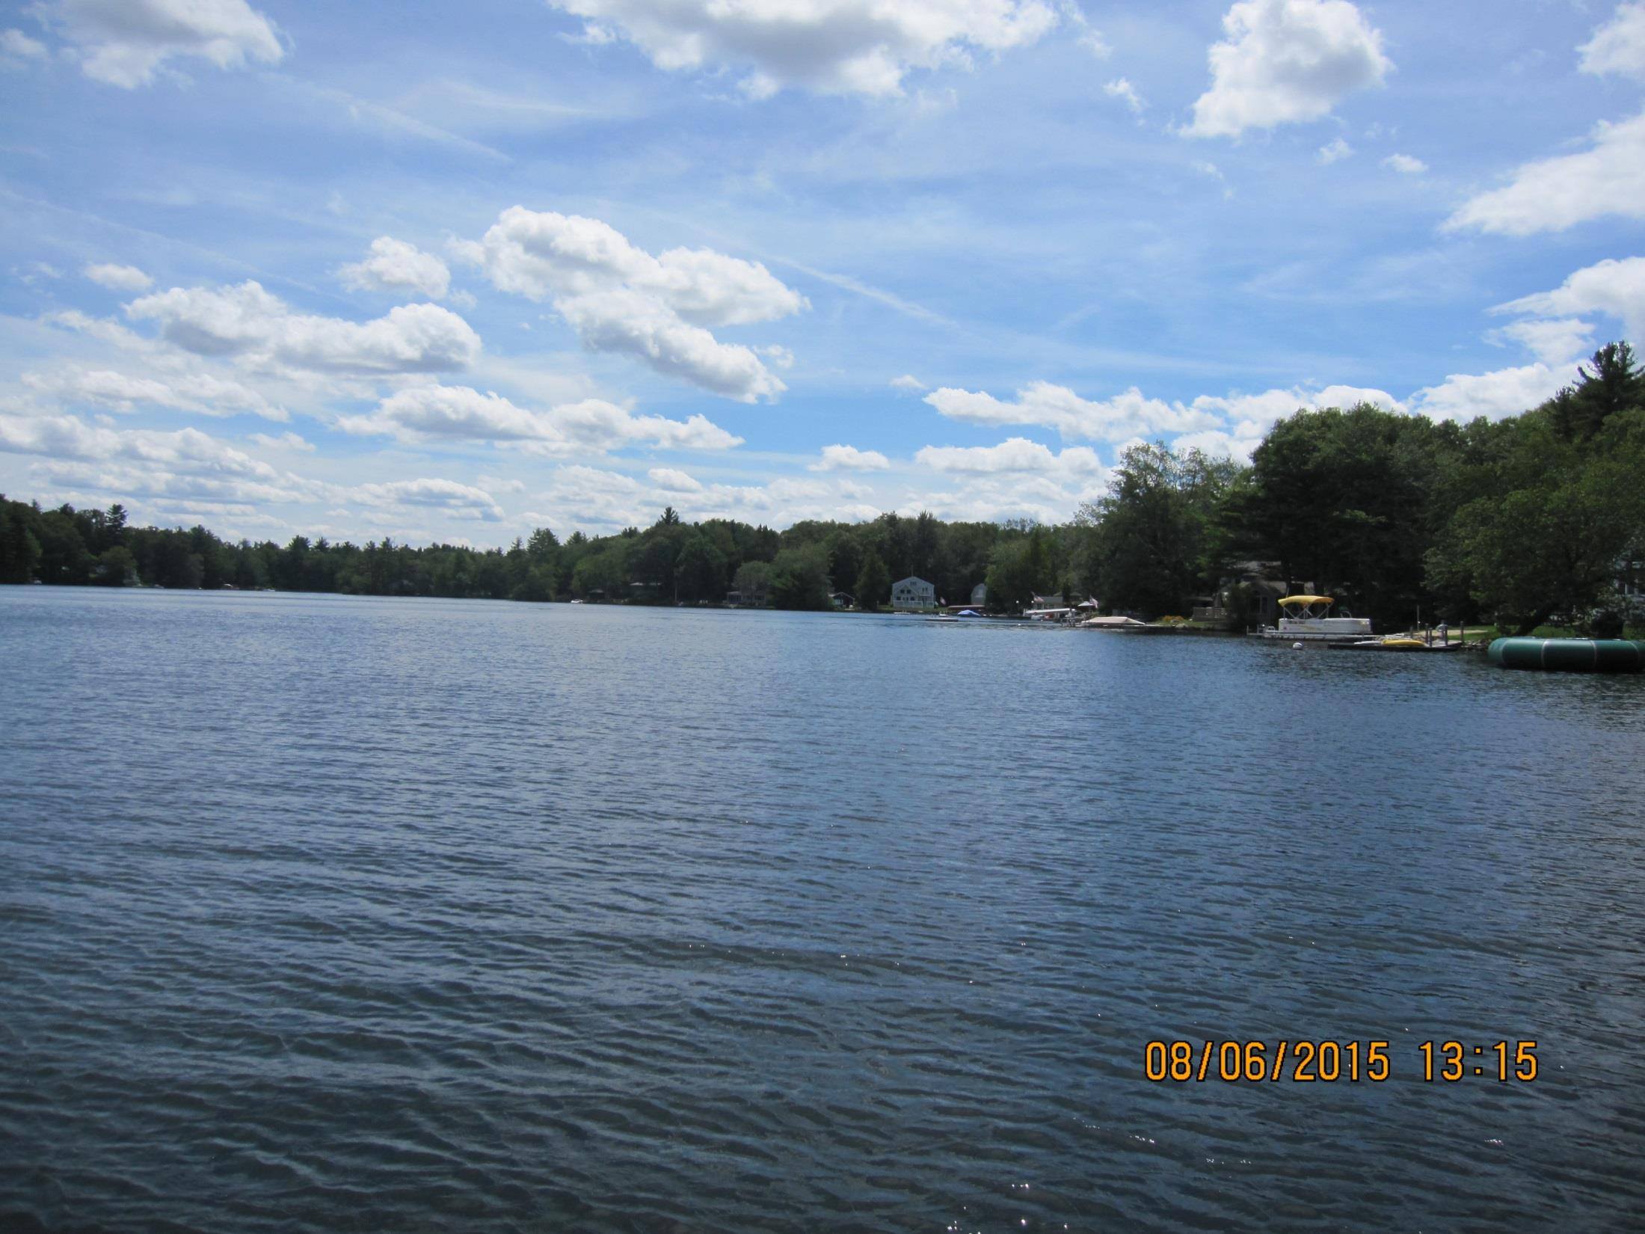
Lake Maspenock Management Plan Development and Implementation
Presented by the
Lake Maspenock Aquatic Vegetation Control and Management Advisory Group
in cooperation with the
Hopkinton Conservation Commission and Parks and Recreation Department

Slide 2
Lake Maspenock Aquatic Vegetation Control and Management Advisory Group
Board of Selectmen's Charge:
Designees/Stakeholders:
The Citizen Input Group shall make recommendations to the Director of Public Works (DPW) regarding measures to facilitate effective public participation in the formulation of the Comprehensive Weed Management and Control plan (The Plan) at Lake Maspenock.
Conservation Commission
Parks and Recreation Commission
Lake resident with knowledge of prior weed control
Two at-large members

Slide 3
The Role of the Advisory Group
Insuring that factual information regarding treatment options is communicated;
Coordinating, consulting and providing methods and means for seeking public input; ensuring effective public participation at the meetings and that public input is fully considered;
Formulating methods and means of increasing public awareness about the benefits, cost and potential for health or ecological risks of The Plan.

Slide 4
What does this really mean?
Advisory Group is tasked with finding a workable long-term solution for the Lake’s nuisance weeds;
We start with an open mind and consider all potential options - keep those that might work and eliminate those that are not feasible, not effective, or too costly;
Keep public well-informed by transparent decision-making, educational public meetings, and soliciting resident feedback; and
Decide on a reasonable, comprehensive approach and initiate plan. We expect the approach to adapt and evolve over the long-term.

Slide 5
Lake Maspenock is a Great Pond !
Lake Maspenock (a.k.a North Pond) is a recognized “Great Pond” by the Commonwealth of Massachusetts
The name comes from the Nipmuc dialect of Eastern Algonquin translated as 'The Waters At The Base Of The Great Hill‘
Natural state of pond is about 30-40 acres but it size has been gradually increased by a series of impounding dams and currently is about 234 acres*
Shoreline shared by Hopkinton, Upton and Milford
* Information from Lake Maspenock at: http://www.lmpa.org/history/

Slide 6
Lake Maspenock Hopkinton, Upton, and Milford, MA
Sur­face area is 234 acres. The lake is approx­i­mately 2 miles long and 2,000 ft wide at its widest part
Watershed area is estimated at 1,813 acres. Part of Blackstone River drainage.
Outlet flow estimated at 28 cfs. Hydraulic retention time is 260 days or annual flushing rate of 1.4 exchanges per year
Average water depth is 8 feet. Current drawdown practice is typically 5 ft with maximum 8 ft on third year.
Source: Aquatic Control Technology (2012)

Slide 7
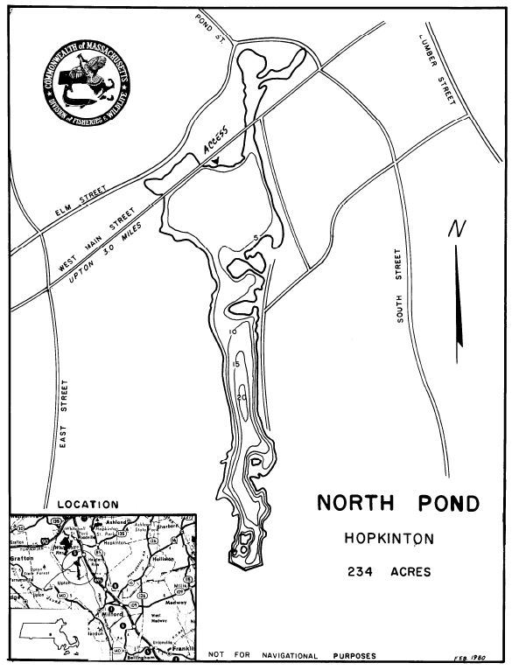
Lake Maspenock
Bathymetric Map
Map indicates lake bottom (depth) contours
Source: MA DFW website:
http://www.mass.gov/eea/docs/dfg/dfw/habitat/maps-ponds/dfwnrtho.pdf

Slide 8
Aerial photograph of Lake Maspenock January 6, 2016
West Main Street Crossing
Dewatered North Basin of Lake
Woody Island
Sandy Beach Island (Town Beach)
Outlet Dam Structure in Milford

Slide 9
Lake Maspenock Outlet Structure at South End (Milford)

Slide 10
Lake Maspenock Water Uses/Issues
Major Uses of the Lake:
Swimming: Town’s public beach on Sandy Beach Island
Boating: Public boat launch area located off Sandy Beach Island; many shoreline docks
Fishing: Open water and ice fishing popular
Other current/historic uses - wildlife habitat, industrial
Diagnostic Feasibility (D/F) study from late 1980s; recommended dredging and stormwater treatment
Review of water quality data from 1970s to present indicates improved water quality/clarity
Current major concern is how to safely address impairment of recreational use and ecological habitat value by dense growth of aquatic weeds

Slide 11
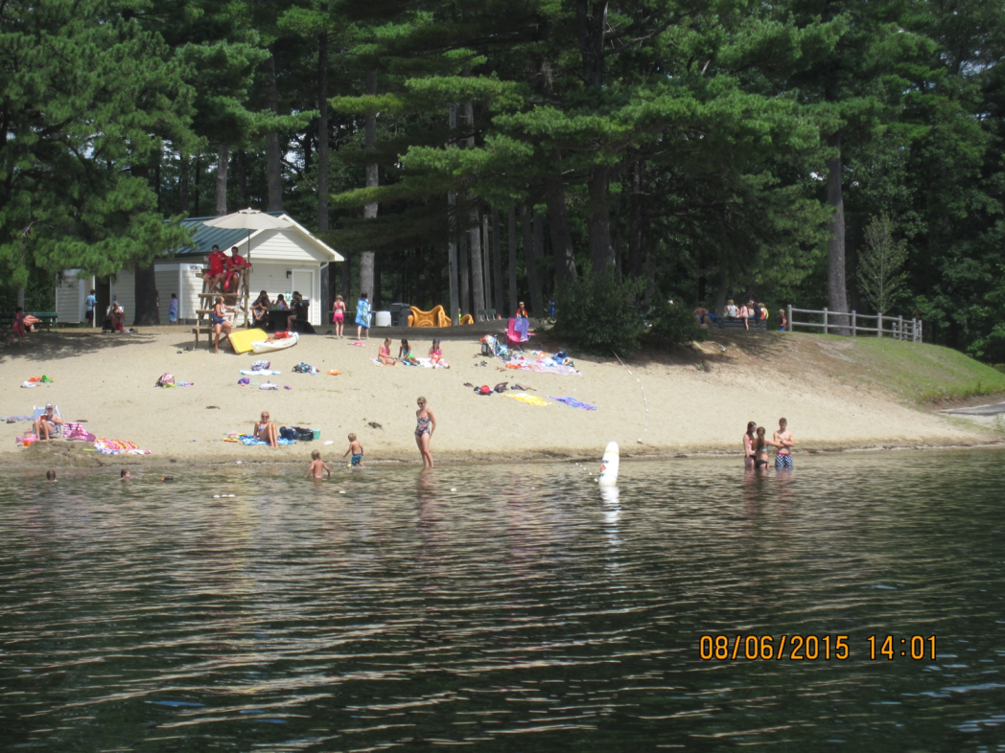
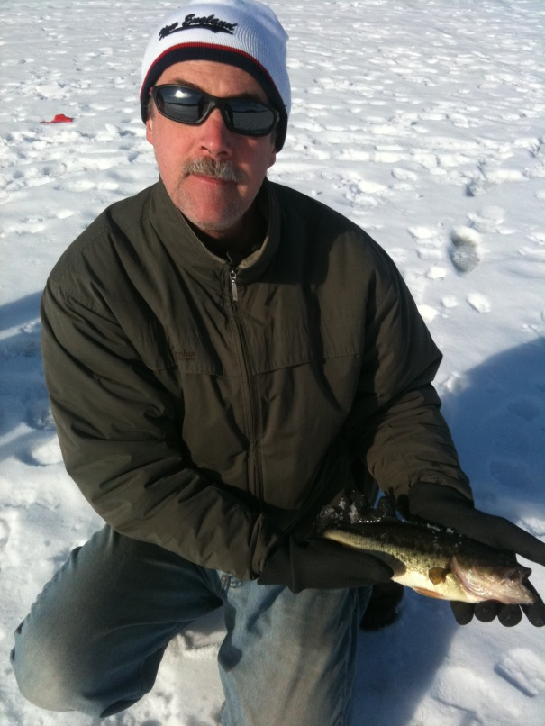
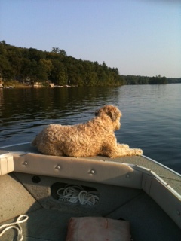
Lake Maspenock Popular Uses

Slide 12
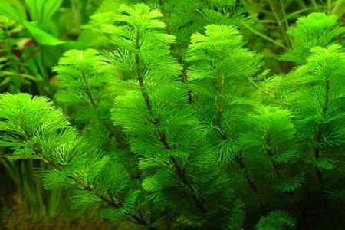
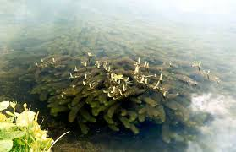
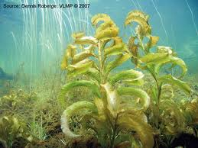
Lake Maspenock Aquatic Weeds
Fanwort (Cabomba caroliniana)
Variable milfoil (Myriophyllum heterophyllum)
Largeleaf Pondweed
(Potamogeton amplifolius)

Slide 13
Lake Maspenock Aquatic Vegetation Distribution Map* (2012)
Abundant plant growth found in areas where water depths are 8-10 ft or less
Three non-indigenous, invasive species of concern:
Variable watermilfoil (Myriophyllum)
Fanwort (Cabomba)
Brazilian elodea (Egeria)
Aquatic vegetation control efforts has been successful in controlling invasives but native species have now proliferated:
Naiad (Najas)
Largeleaf Pondweed (Potamogeton)
Source: Aquatic Control Technology (2012)

Slide 14
Lake Maspenock Aquatic Vegetation Control Management Option Screening Process Overview
Aquatic Veg. Control Options
Screening Step Notes
MA GEIR options plus new methods introduced >2004
1.) Phase 1 – Consider all possible methods and eliminate methods which are clearly not applicable or appropriate to LM
Screen out all obviously inappropriate methods based on LM characteristics (size, depth, flushing rate)
Potential options for Lake Maspenock
2.) Review potentially applicable methods, eliminate those which may not be effective, are too costly, or have other concerns
Apply criteria of technical feasibility, effectiveness, human health and ecological effects, cost, longevity, and compatibility
Refined list of aquatic veg. management options for Lake Maspenock
3.) Identify suite of effective options and put together a lake-specific management plan to control aquatic vegetation
Evaluate options for compliance and support of Lake Maspenock aquatic vegetation management plan: overall goals, areas to be treated, treatment priorities, short-term and long-term objectives , funding opportunities, and watershed stewardship
Select short-term controls
4.) Integrate selection of short-term control options with longer-term watershed planning and management (e.g., 5-year plan)
Select longer -term options

Slide 15
Lake Maspenock Aquatic Vegetation Control Management Option Screening Process – Phase 1
Aquatic Veg. Control Options
Identify and consider complete suite of potential management options for aquatic weed control. Evaluate physical, chemical and biological control methods.
1.) Phase 1 – Consider all possible methods and eliminate methods which are clearly not applicable or appropriate to LM
Decision Step: Screen out all obviously inappropriate methods based on nature of control or lake characteristics (e.g., size, depth, flushing rate)

Slide 16
Process used to Identify Potential Weed Control Methods/Techniques
Review previous studies of Lake Maspenock and earlier vegetation control efforts
Consult MA DEP/EOEA (2004) ‘Generic Environmental Impact Statement for Eutrophication and Aquatic Plant Management in Massachusetts (GEIR)’
Research new approaches, updated techniques, and successful implementations
Technical support from Certified Lake Manager

Slide 17
Commonly accepted physical methods used for aquatic weed control
1. Benthic Barriers
1.a Porous Materials
1.b Non-Porous Materials
1.c Sediment Barrier
2. Dredging
2.a "Dry" excavation
2.b "Wet" dredging
2.c Hydraulic dredging
3. Surface covers and dyes

Slide 18
Review of Physical Controls – Example of Phase I screening
1. Benthic Barriers
1.a Porous Materials
1.b Non-Porous Materials
1.c Sediment Barrier - can’t place fill in lake basin
2. Dredging
2.a "Dry" excavation – can’t fully drain the lake basin
2.b "Wet" dredging
2.c Hydraulic dredging
3. Surface covers and dyes – lake size prohibitive

Slide 19
Physical methods used for aquatic weed control (continued)
4. Mechanical harvesting
4.a Hand-pulling or diver-assisted removal
4.b Cutting (no collection)
4.c Cutting (w/ collection)
4.d Rototilling
4.e Hydroraking
5. Water Level Control
5.a Drawdown
5.b Flooding

Slide 20
Physical Controls – Phase I screening
4. Mechanical harvesting
4.a Hand-pulling or diver-assisted removal
4.b Cutting (no collection) –organic material decays
4.c Cutting (w/ collection)
4.d Rototilling – not used for nuisance weed control
4.e Hydroraking – used for deep-rooted woody stems
5. Water Level Control
5.a Drawdown – already being practiced
5.b Flooding – increased water potential flooding

Slide 21
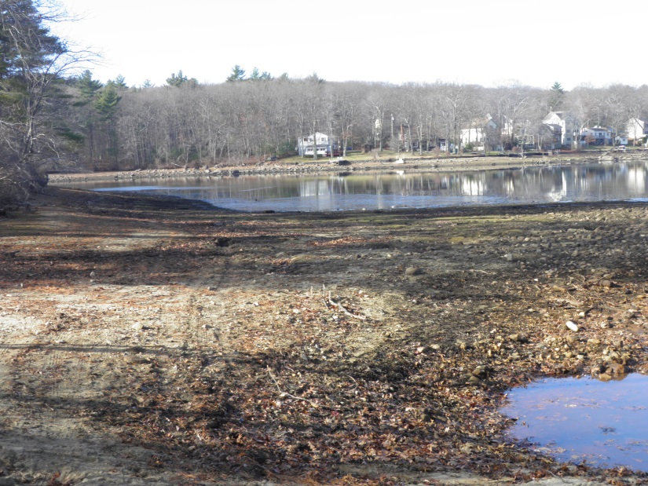
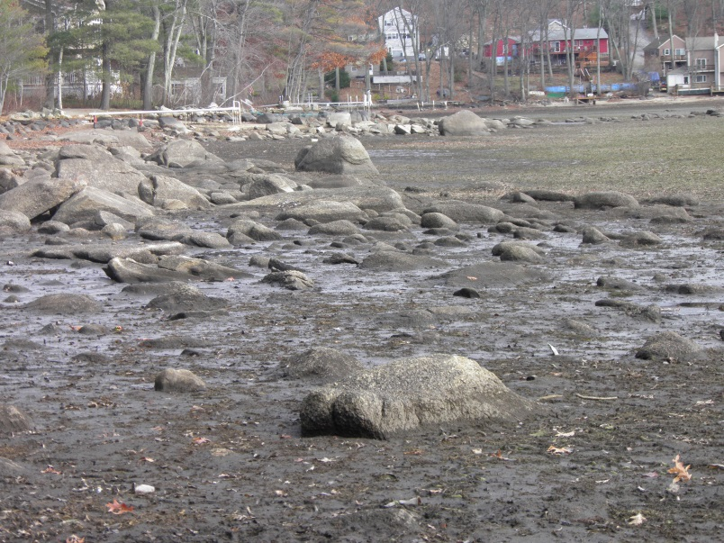
Winter Drawdown (2015-2016)
Sandy Beach Boat Ramp Area
West Main St. public access

Slide 22
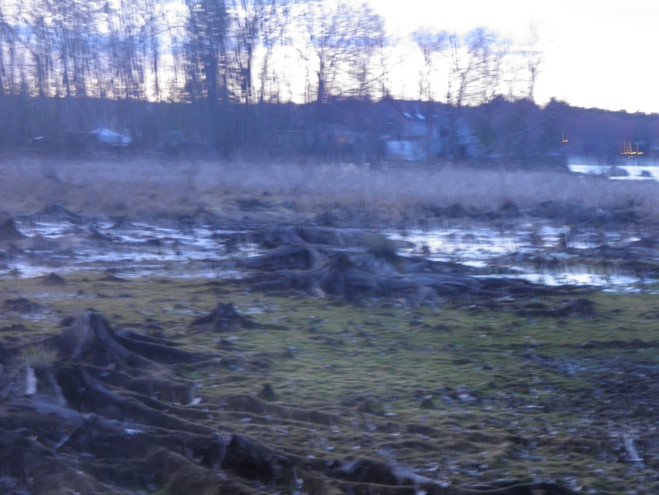
Winter Drawdown (2015-2016)
Marshy area along Hayward St.
Milford shoreline toward dam

Slide 23
Chemical Controls for Aquatic Weed Management
6. Herbicides
6.a Copper-based algaecides
6.b Diquat
6.c Endothall
6.d Flumioxazin
6.e Fluoridone
6.f Glyphosate
6.g Imazamox
6.h Imazapyr
6.i Penoxsulfam
6.j Peroxide-based
6.k Triclopyr
6.l 2,4-D

Slide 24
Chemical Controls - Phase I Results
6. Herbicides
6.a Copper-based algaecides
6.b Diquat
6.c Endothall
6.d Flumioxazin
6.e Fluoridone
6.f Glyphosate
6.g Imazamox
6.h Imazapyr
6.i Penoxsulfam
6.j Peroxide-based
6.k Triclopyr
6.l 2,4-D
Herbicides were eliminated based on their target plants or algae. Those retained have demonstrated effective control of one or more of the three major nuisance species: Fanwort, Variable Milfoil, or Largeleaf Pondweed.

Slide 25
Biological Controls for Aquatic Weed Management
7. Biological Controls
7.a Herbivorous fish
7.b Herbivorous insects
7.c Bacterial/viral pathogens
7.d Selective Planting
7.e Biomanipulation by fish stocking

Slide 26
Biological Controls - Phase I Results
7. Biological Controls
7.a Herbivorous fish – not legal in Massachusetts
7.b Herbivorous insects
7.c Bacterial/viral pathogens – not for plant control
7.d Selective plantings - not feasible for weed mgmt.
7.e Biomanipulation by fish stocking – works on algae

Slide 27
Lake Maspenock Aquatic Vegetation Control Management Option Screening Process – Phase 2
Aquatic Veg. Control Options
Continue to refine list of physical, chemical and biological control methods using against key factors.
2.) Review potentially applicable methods, eliminate those which may not be feasible or not effective, are too costly, or have other concerns
Decision Step: Apply criteria of technical feasibility, effectiveness, human health and ecological effects, cost, longevity, and compatibility

Slide 28
How will the Advisory Group evaluate and select lake management options?
We look at these key factors:
Feasibility – could we do this on Lake Maspenock?
Effectiveness – how well does the option work?
Human health and ecological effects – is it safe?
Cost – what is the cost (total or $/per acre)?
Longevity of treatment – how long does it last?
Compatibility with other options – does it complement the beneficial effect of other options?
Final options will include both short-term and long-term management

Slide 29
Lake Maspenock Aquatic Vegetation Control Management Option Screening Process – Phases 3 & 4
Aquatic Veg. Control Options
Use “Toolbox” of promising and safe aquatic vegetation management options for Lake Maspenock and combine them to develop short-term and long-term management goals
3.) Identify suite of effective options and put together a lake-specific management plan to control aquatic vegetation
Decision Steps: Evaluate options for support of LM aquatic vegetation management plan: overall goals, treatment areas, treatment priorities, short- and long-term objectives , funding opportunities & watershed stewardship
Select short-term controls
4.) Integrate selection of short-term control options with longer-term watershed planning and management (e.g., 5-year plan)
Select longer -term options

Slide 30
Advisory Group Progress to date
We reviewed important previous studies of the lake and water quality reports to learn more about the Lake and its watershed.
We identified potential weed control methods described in the State technical guidance (GEIR), similar documents for other states, and applicable information available on the internet.
We have prepared a lake user’s survey to get a better definition of who uses Lake Maspenock, what they like to do on the lake, and their impressions on the current lake experience. Please participate at: http://kwiksurveys.com/s/I5qy2QZO

Slide 31
Advisory Group Progress (cont.)
Group met with representative from Lake Cochituate (Wayland) describing their experience with nuisance weed control and finding public consensus
Conducted a Phase I screening to eliminate aquatic weed control methods which are clearly not applicable or appropriate to the Lake
Scheduled two public forums in February to present and discuss the current status of Plan with Town residents and get input from stakeholders

Slide 32
Next Steps and Timeline
Advisory Group Review and Develops Draft Long-Term Management Plan for Aquatic Weed Control
Group Presents Plan at public meetings to provide information and solicit feedback from Town
February 9th at 7:00 - 8:30 pm at Hopkinton Town Hall
February 27th at 10:00 – 11:30 am at Town Hall
Advisory Group finalizes Management Plan and makes copies available to public
Submit recommendations to Board of Selectmen

Slide 33
Over the next few weeks….
As the Lake Maspenock Watershed plan continues to develops, the Advisory Group will provide updates and additional details.
For additional information regarding the Advisory Group and its activities, feel free to contact the Hopkinton DPW Director, John Westerling, at: jwesterling@hopkintonma.gov

Slide 34
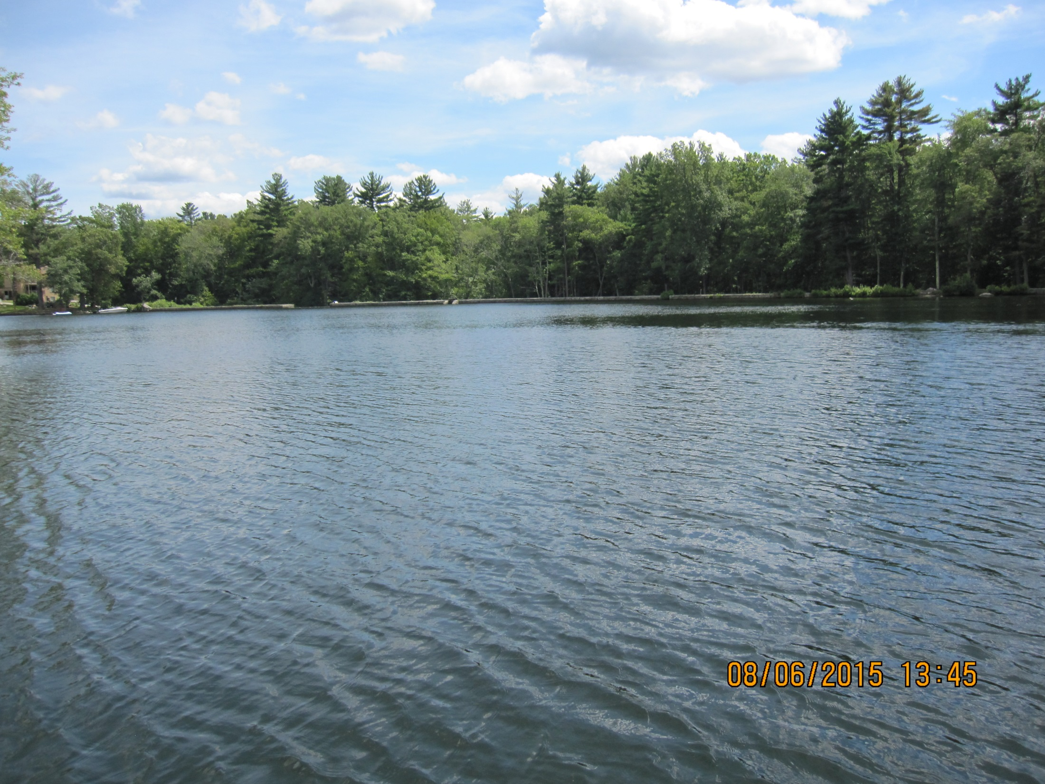
QUESTIONS ?

